Slide 1

Notes:
Open-source software package providing a complete pipeline from medical image data segmentation to patient-specific blood flow simulation and analysis.

Slide 2
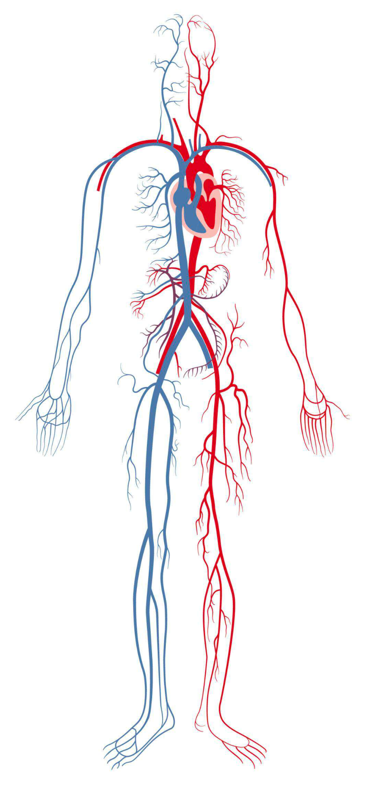
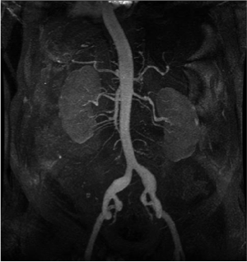
heart
veins
arteries
X-Ray images of aorta and iliac arteries
Notes:
Instead of IMAGE DATA
Say it is XRAY or image of someone’s
Relate that this is like an XRAY (but instead of bones, it’s for viewing blood vessels)

Slide 3
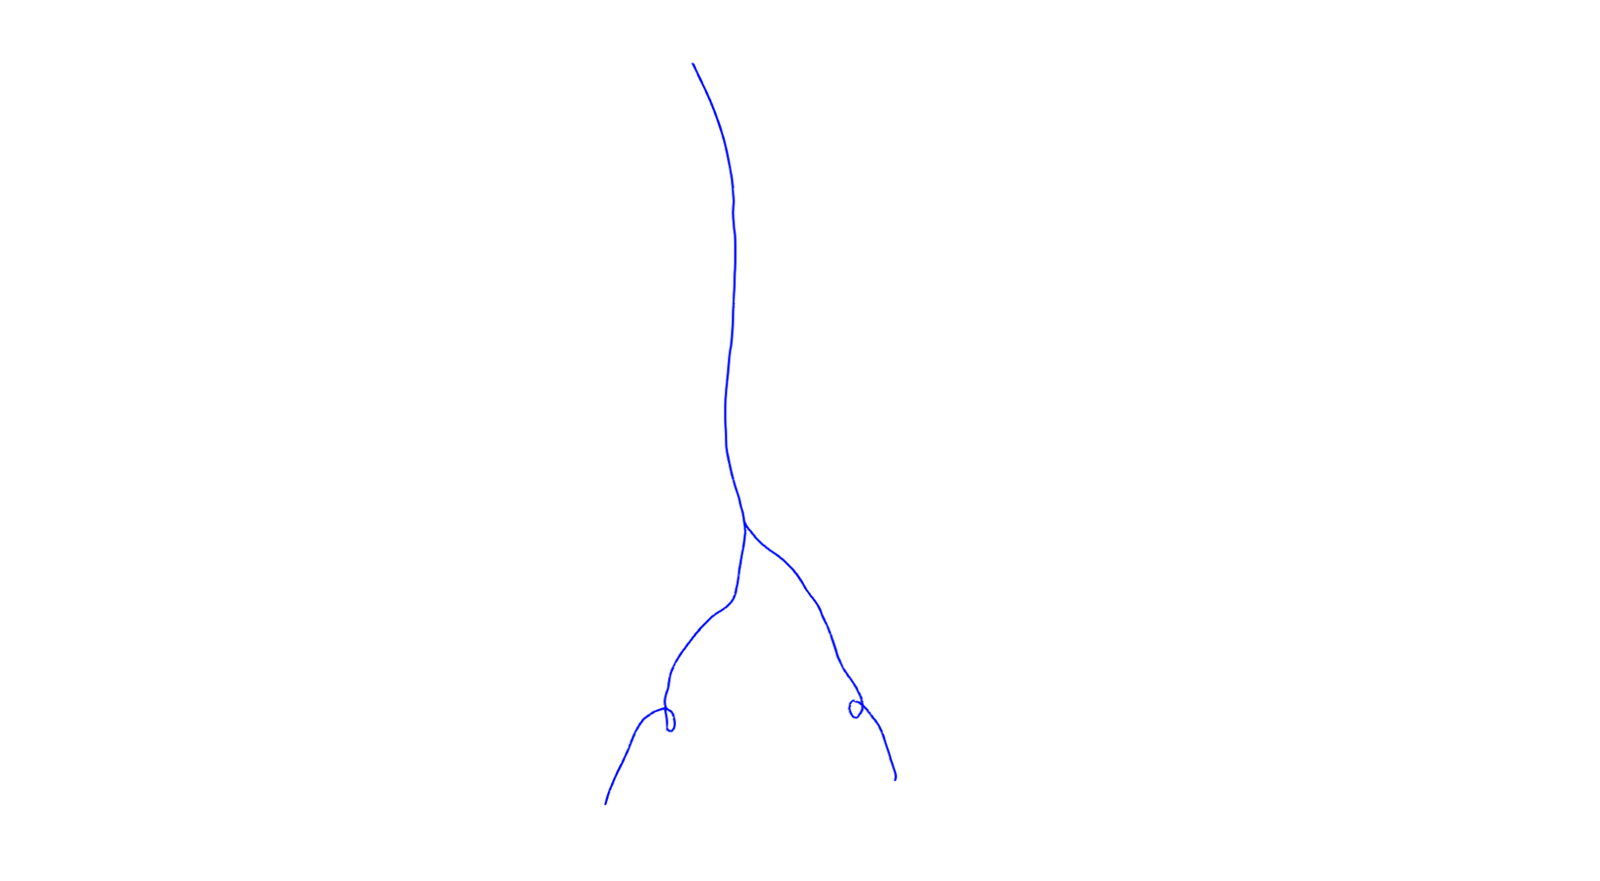
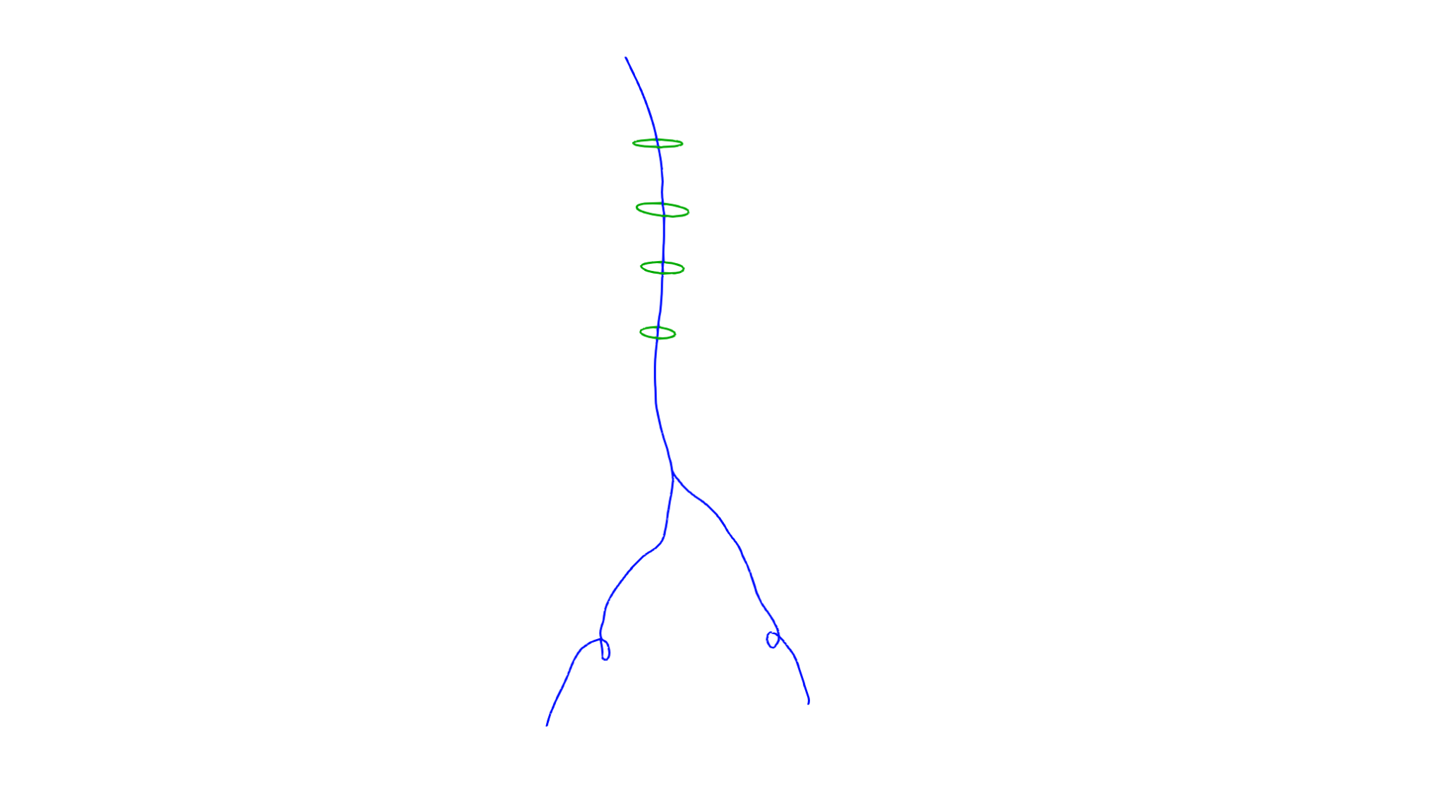
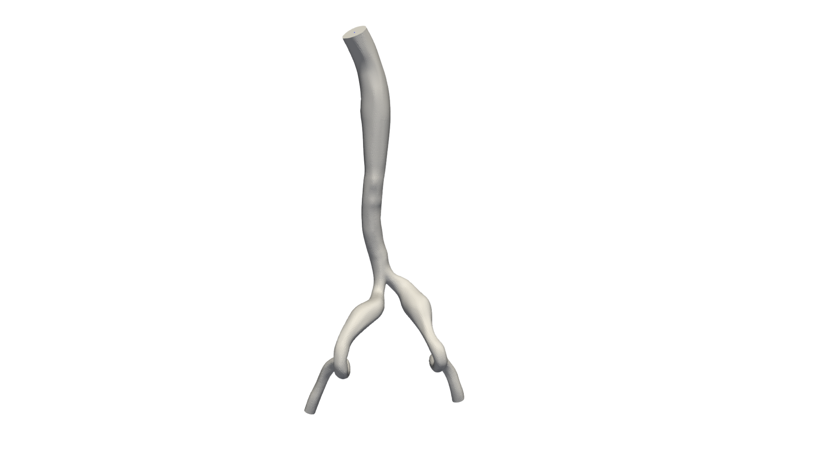
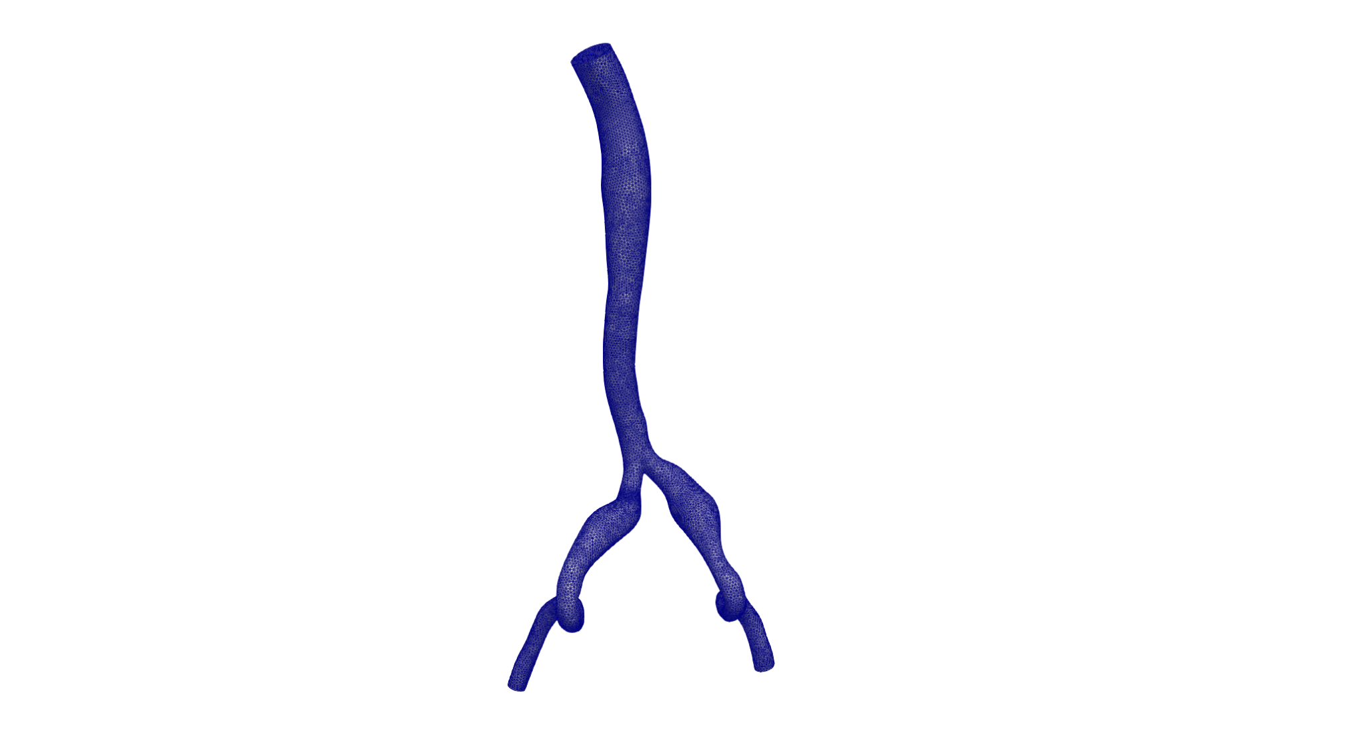
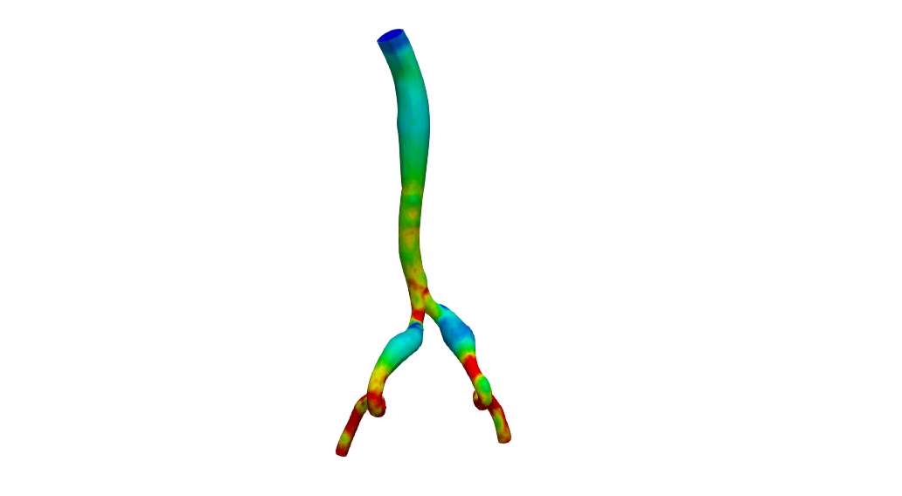
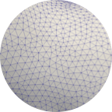
PATH
SEGMENTATION
GEOMETRIC MODEL
MESH
SIMULATION
We will build models of these blood vessels!
Notes:
Someone might ask
Why do you need a mesh?
Put a connection from image to the modeling pipeline
Can we yeet model or mesh? What is the most important thing to show
Relate blood flow to these pipes
anot

Slide 4
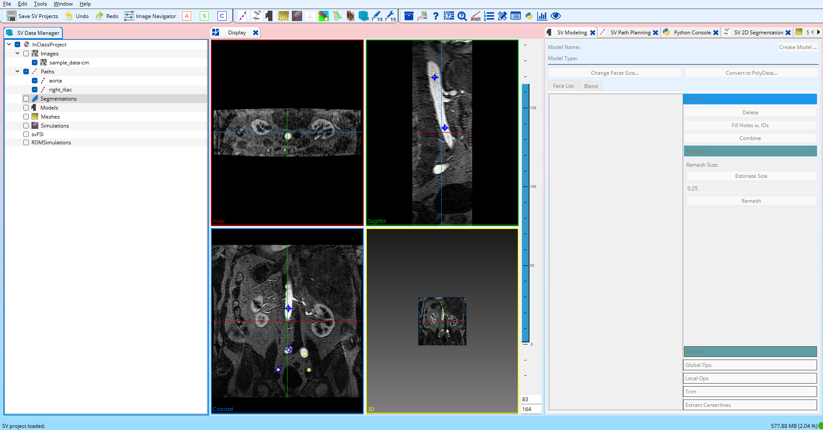

Slide 5
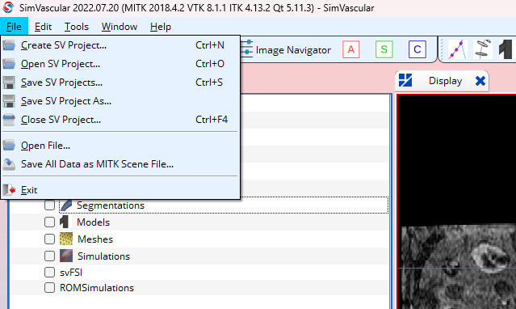

Slide 6
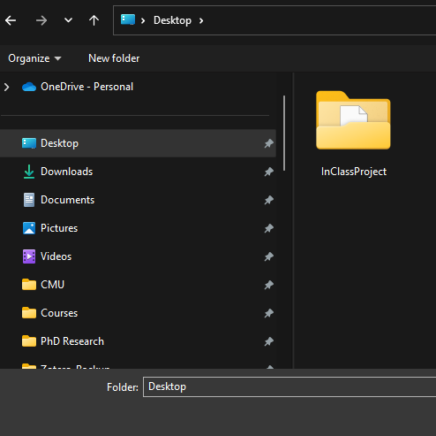

Slide 7
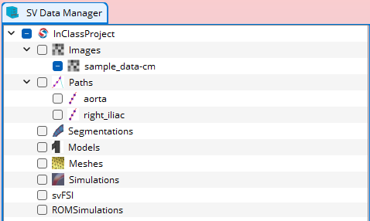
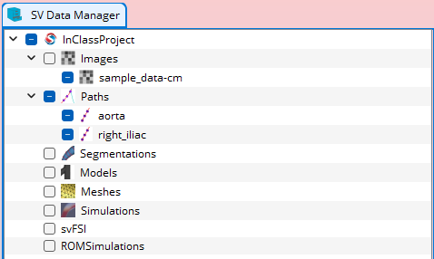
Click the empty box besides Paths

Slide 8
We will create segmentations of the aorta and right iliac arteries

Slide 9
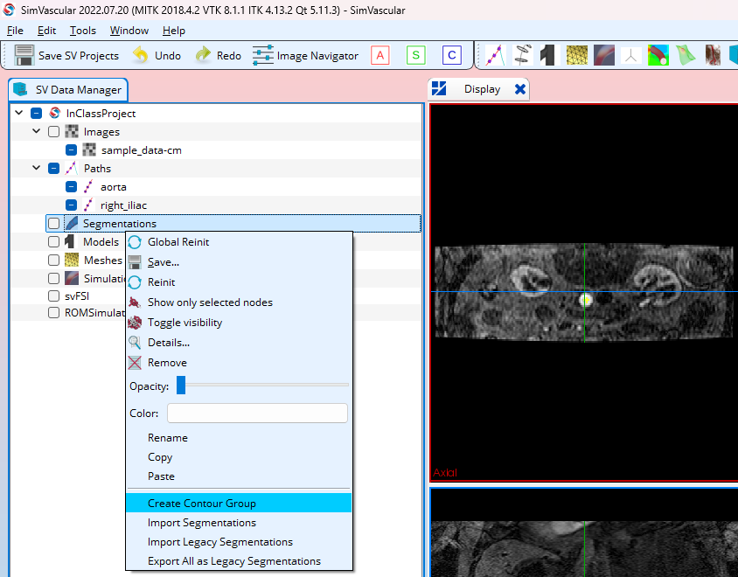
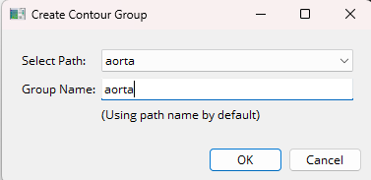

Slide 10
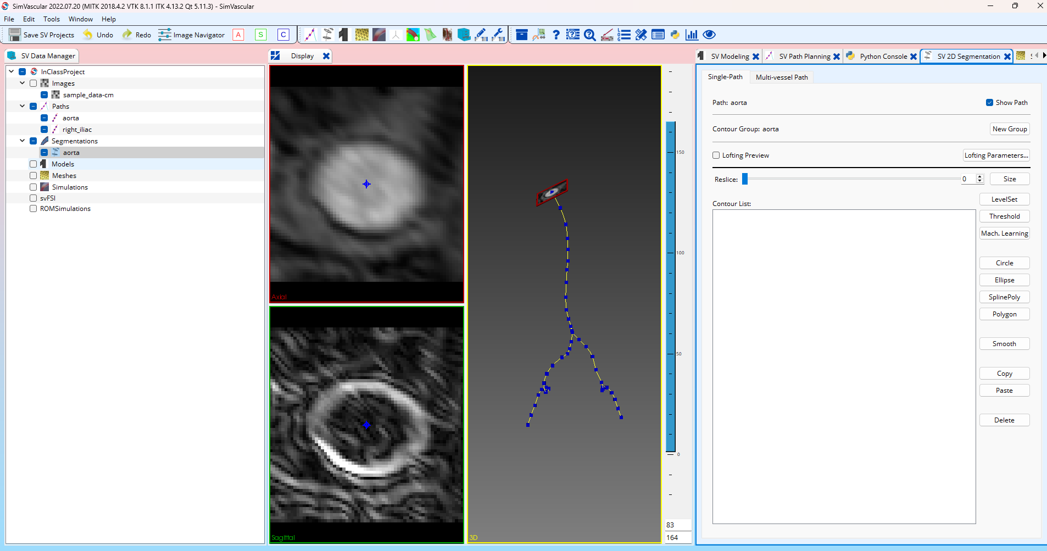
Double click the aorta segmentation we created

Slide 11
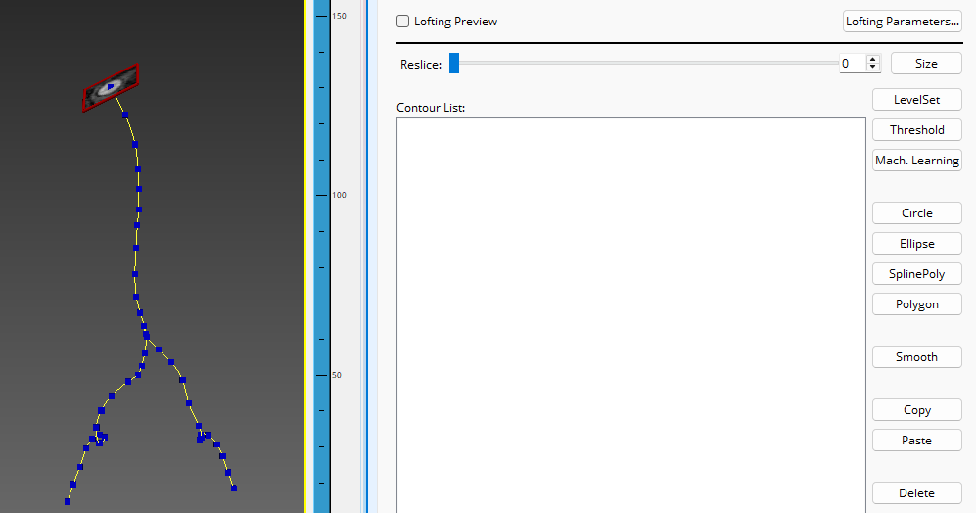
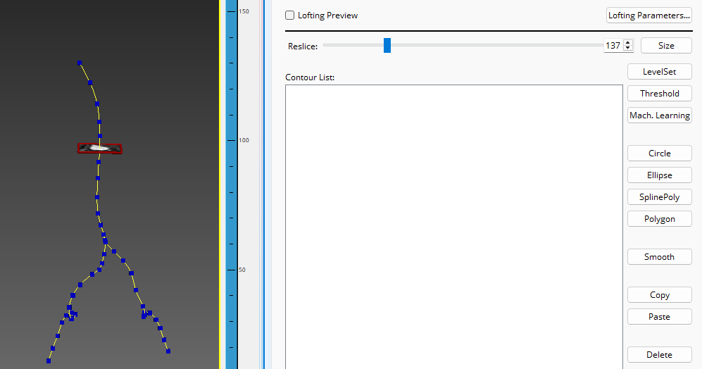
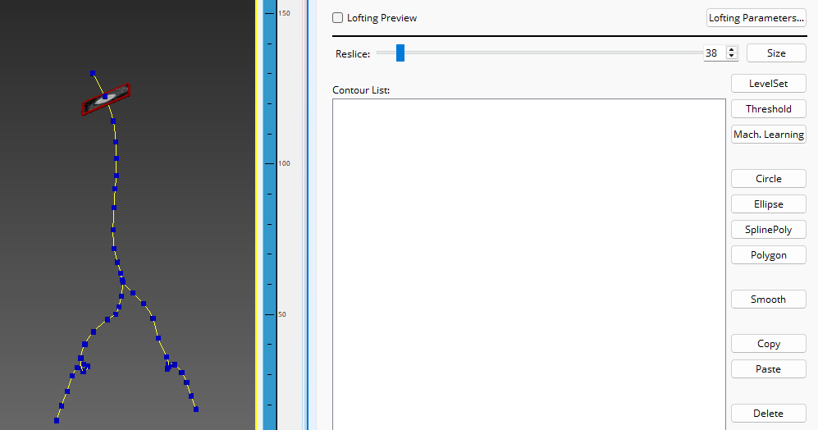
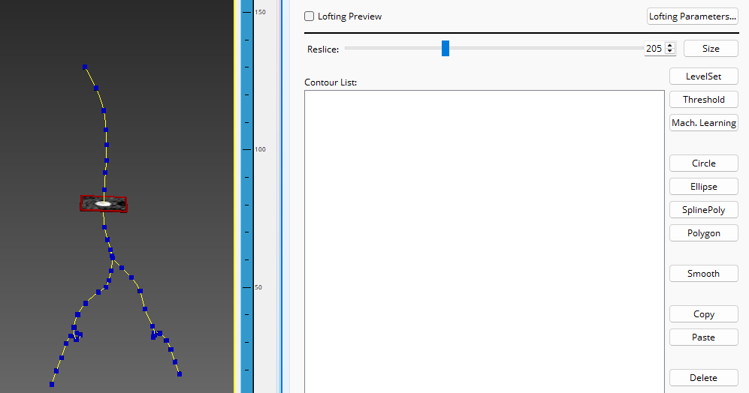

Slide 12
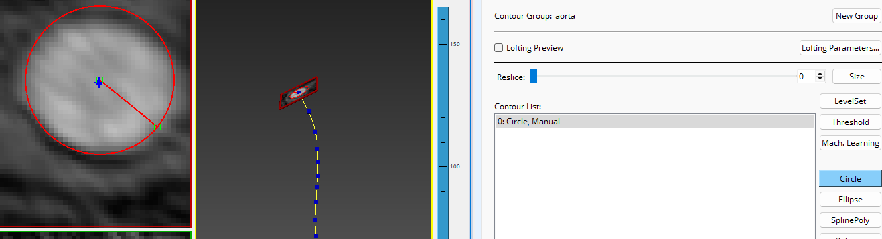
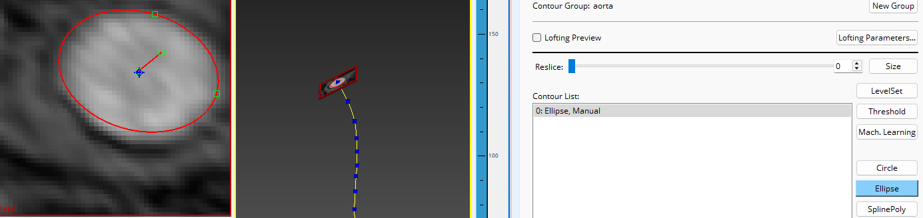

Slide 13
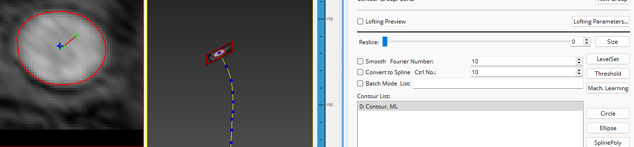
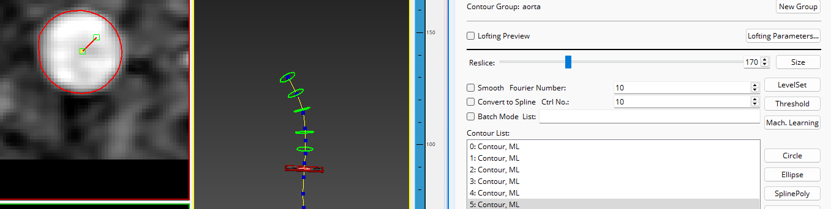

Slide 14
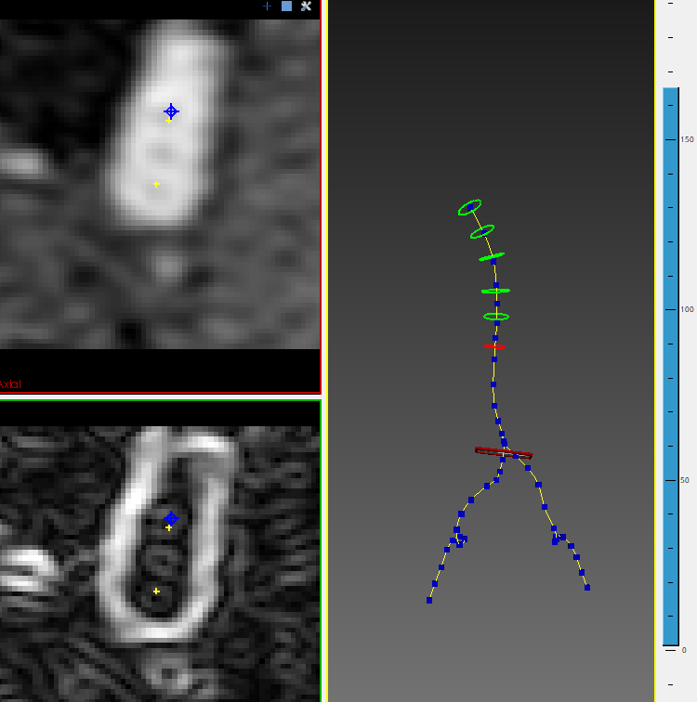
Sometimes, it is hard to tell where the blood vessels are in CT images!
Let’s try to skip past them.

Slide 15
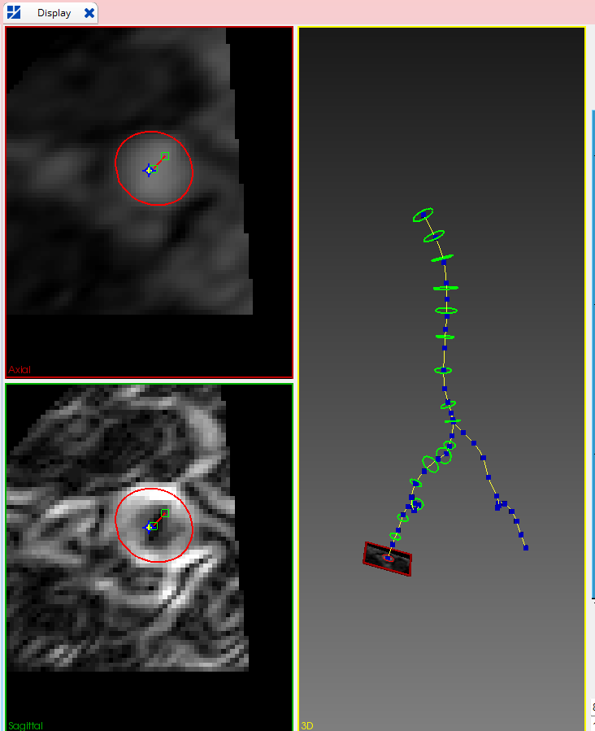
Once we have added enough segmentations, we will build our model for the aorta

Slide 16
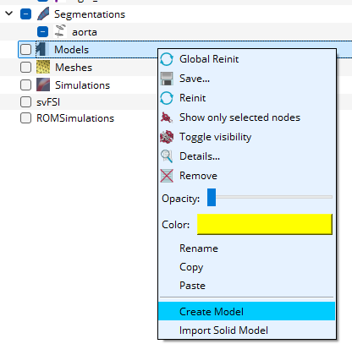
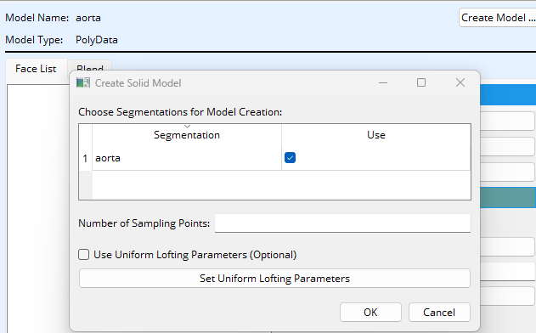
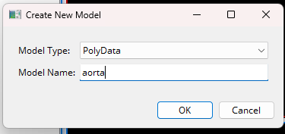

Slide 17
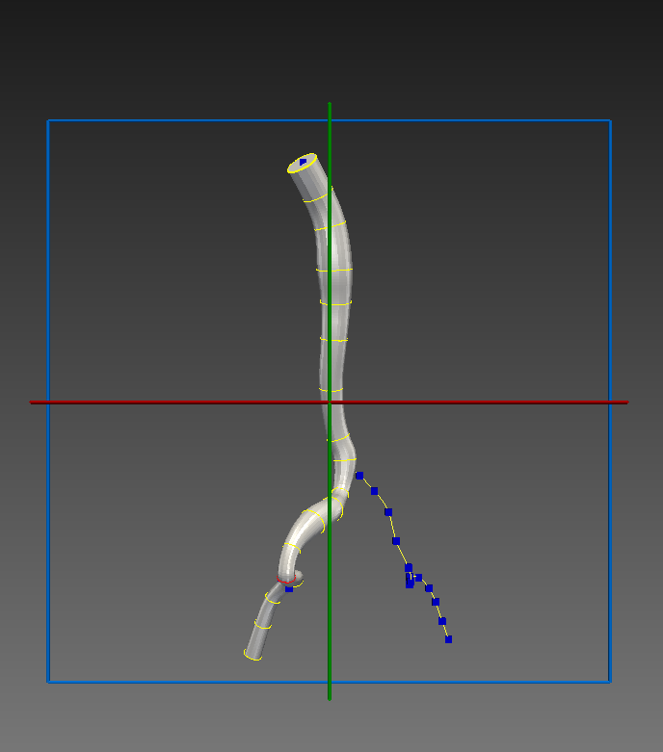
We have built our first model!
Now, we need to repeat this process for the right iliac artery

Slide 18
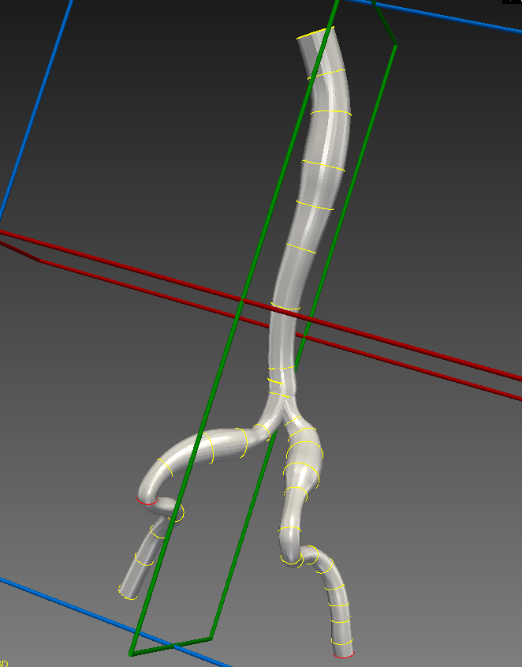
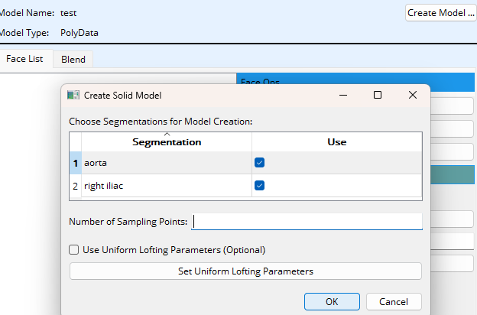
How do we make a model of both arteries? We select both segmentations!

